Slide 1
Lab 4
I/O in an Embedded System
Julio César Almada Fuerte
A00226046
ITE

Slide 2
PART 1
Use the 7-segment display to display a digital number, but now you are going to use the key buttons.
KEY0: Sets the number on the display to 0.
KEY1:Increments displayed number.
KEY2:Decrements displayed number.
KEY3:Blanks the display, it is turned on until any other key is pressed

Slide 3
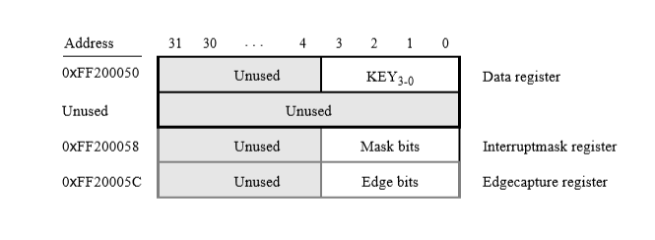
Push buttons are detected through polling, to read the Data register. There you can see when a button is pressed.
If not pressed, data register provides 0
If “i” button is pressed, data register provides the value 1 in “i” position.

Slide 4
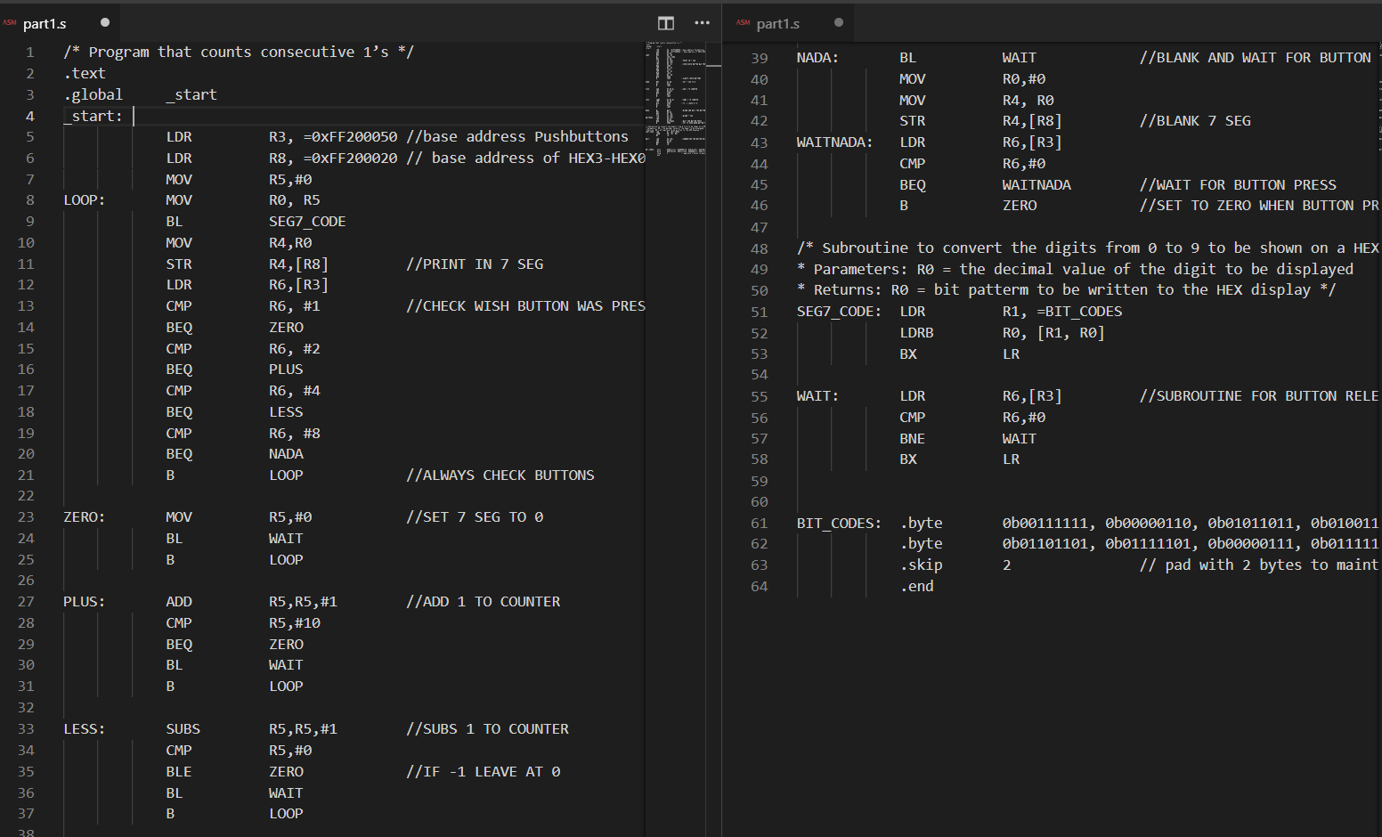

Slide 5
PART 2
Counter from 0 to 99 in a loop, increments every .25 seconds. (Delay provided)
Counter should stop if a button is pressed. (Use the Edgecapture register, when a button press happens, it is set to 1 and remains until anything is written into the register).

Slide 6
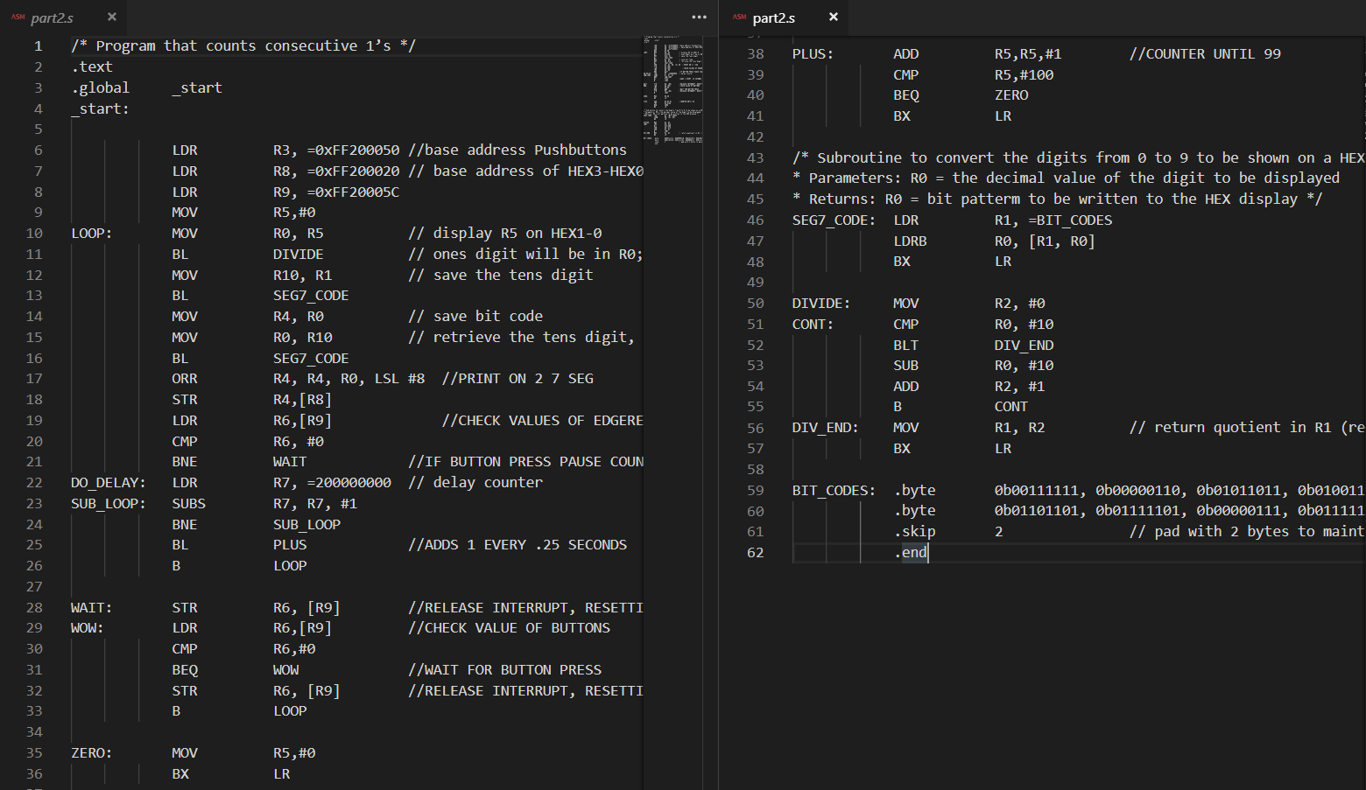

Slide 7
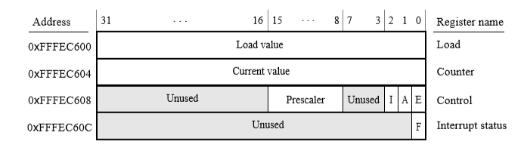
PART 3
Does the same of part 2, but now using the A9 Private timer registers for the delays.
Write a value to the Load register, set E to 1 to start the timer. The counter will reload the Load register and continue if A is 1. When it reaches 0, F is set to 1(This bit has to be polled).To reset F write 1 into it.

Slide 8
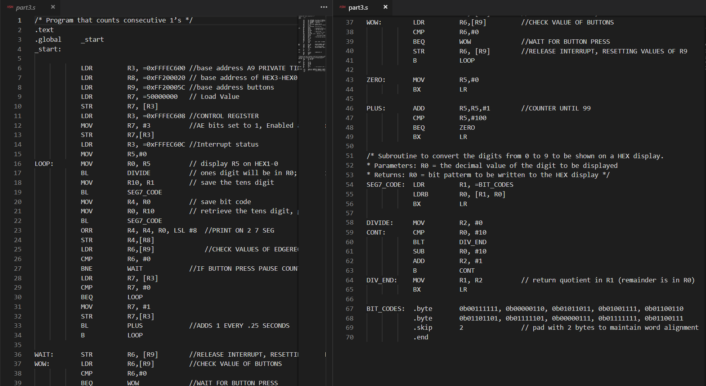

Slide 9
PART 4
Use all your knowledge acquired to implement a real-time clock. Display it on the 7 – segments. It has to work on this format= SS:DD (Seconds:Hundredths of a second).
Polled I/O with the A9 Private timer.
Should stop/run with any button press.

Slide 10
